Slide 1
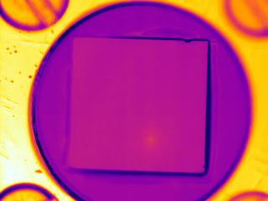
Exploring Free Carrier Diffusion with Light- and Heat-Generating Recombination
Ryan Crum and Tim Gfroerer
Davidson College
Mark Wanlass
National Renewable Energy Lab
Funded by the American Chemical Society – Petroleum Research Fund

Slide 2
Generation of Electricity!!
Conduction Band
E-Field
-
-
-
-
-
Energy
Photon
Band Gap
+
+
+
+
+
Valence Band
E-Field

Slide 3
The difference between light- and
heat-generating recombination
Heat-Generating Recombination
Light-Generating
Recombination
electron
electron
-
-
Energy
heat
Defect Level
photon
heat
+
+
hole
hole
Rate ≈ A*n (n = carrier density)
Rate ≈ B*n² (n = carrier density)

Slide 4
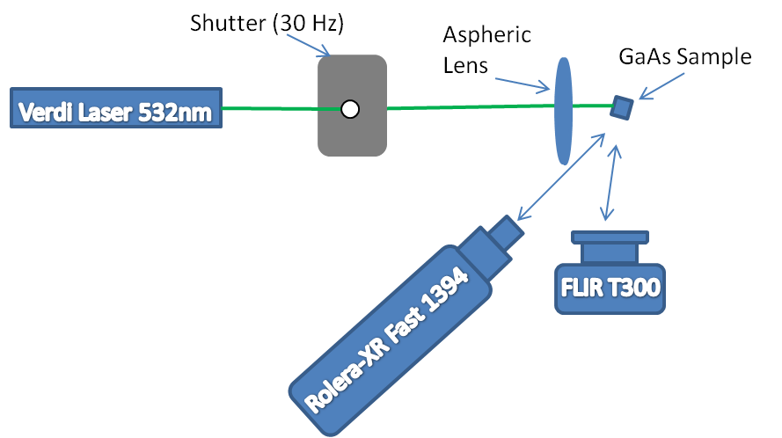
Experimental Set-up
Laser Spot
≈ 4 µm diameter
GaAs Sample
-
-
+
+
+
-
+
-
+
-
+
-
-
+
-
+
-
+
Thermal Camera
+
+
-
+
-
+
-
+
-
+
-
-
-
+
+
-
-
-
+
+
Light Camera
-
-
+
+
+
-
Notes:
The 18mm focal length aspheric lens focuses the 0.34W (only 0.17W is absorbed) Gaussian laser beam to a 4 μm FWHM spot on the sample. In order to optimize the speed of the thermal imaging, a shutter was used to synchronize the laser excitation with individual frames from the FLIR T300 thermal camera (30 Hz).

Slide 5
Diffusion of Heat in GaAs
Notes:
When we analyze a sequence of thermal images where the laser alternates between on and off in consecutive frames, we observe a relatively rapid diffusion of heat radially outward over time. Hence, we study the frame coincident with the first laser pulse to obtain the most accurate representation of the position-dependent heat generation.

Slide 6
Single Pulse Evolution
Heat Loss
Heat Diffusion
Notes:
When we study the evolution of the temperature profile following a single pulse (rather than a sequence of pulses), local heat loss appears to dominate over thermal diffusion.

Slide 7
Analysis of Outward Diffusion of Carriers
Notes:
In past studies, images of luminescence (radiative recombination) have been used to monitor the diffusion of electrons and holes away from the excitation position. In our study, we measure the luminescence profile along with the temperature gradient due to heat generation. We obtain temperature profiles that are broader than the profiles of luminescence. This observation is consistent with how these mechanisms depend on carrier density: heat-generating recombination should be directly proportional to the density of carriers while radiative-recombination is proportional to the density of carriers squared. Since the carrier density decreases with distance from the excitation position, radiative recombination dominates at short distances while heat-generating recombination becomes more important with increasing distance. We test this hypothesis by plotting the square root of the luminescence, which matches the temperature profile surprisingly well.

Slide 8
Continued…Analysis of Outward Diffusion of Carriers
Notes:
In past studies, images of luminescence (radiative recombination) have been used to monitor the diffusion of electrons and holes away from the excitation position. In our study, we measure the luminescence profile along with the temperature gradient due to heat generation. We obtain temperature profiles that are broader than the profiles of luminescence. This observation is consistent with how these mechanisms depend on carrier density: heat-generating recombination should be directly proportional to the density of carriers while radiative-recombination is proportional to the density of carriers squared. Since the carrier density decreases with distance from the excitation position, radiative recombination dominates at short distances while heat-generating recombination becomes more important with increasing distance. We test this hypothesis by plotting the square root of the luminescence, which matches the temperature profile surprisingly well.

Slide 9
Conclusions
We found that the diffusion of carriers is best represented by the temperature difference rather than the light signal.
When analyzing light profiles, the square root of the signal should be used to obtain an accurate measurement of the carrier density.

